Slide 1

MySlice app

Slide 2
It’s Saturday night. Jay and Daisy are at home watching a movie. They’re hungry, but also lazy.

Slide 3
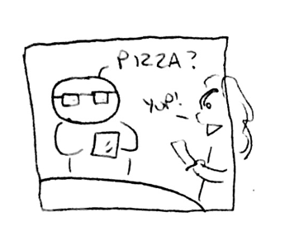

Slide 4
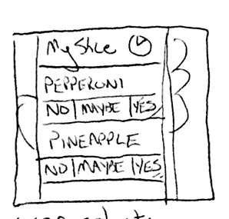

Slide 6
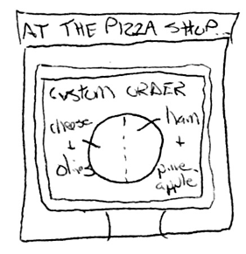

Slide 7
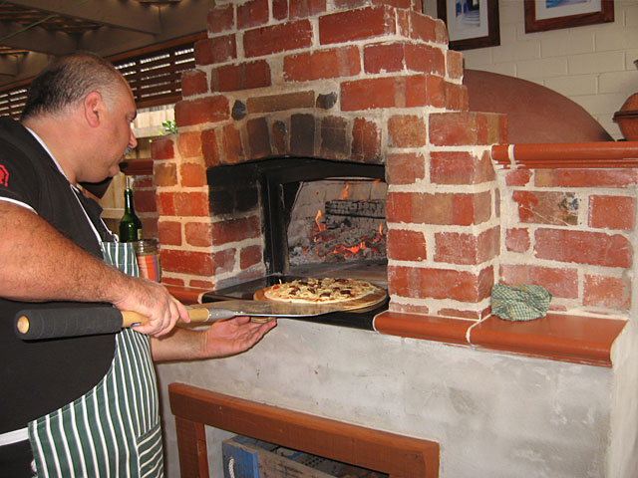
Notes:
http://www.traditionaloven.com/pictures/oven/sam-and-his-wood-oven.jpg

Slide 8
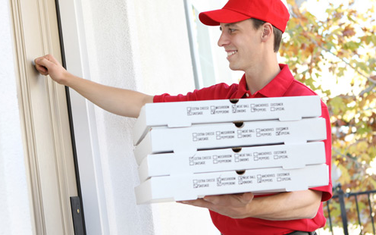
Notes:
http://www.afcins.com/_wp/wp-content/uploads/2012/06/banner-pizza-delivery.jpg.jpg

Slide 9
